Slide 1
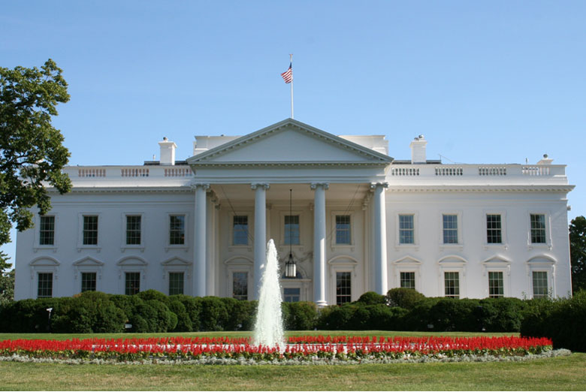
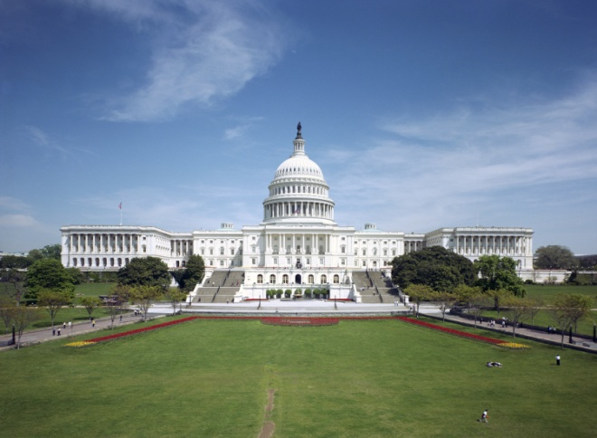
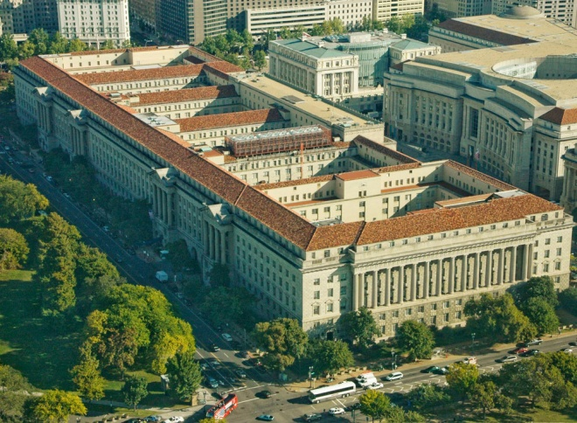
Legislative, Policy, and Budget Update HSRP Norfolk October 26, 2011
Paul Bradley
NOAA National Ocean Service

Slide 2
Outline
NOAA FY 2011 Budget Wrap
FY 2012 Budget Outlook
FY 2013 Budget Status
Legislative Developments
Policy Highlights
Outreach Goals

Slide 3
Budget Timeline
2010 |  |  | 2011 |  |  |  |  |  |  |  |  |  |  |  | 2012
Oct | Nov | Dec | Jan | Feb | Mar | Apr | May | Jun | Jul | Aug | Sep | Oct | Nov | Dec | Jan | Feb
FY 2011
Appropriations/Execution
Budget Execution
FY 2012
OMB Passback
Prepare Pres. Bud.
Rollout Pres. Bud.
Congress: Budget & Appropriations
Budget Execution
FY 2013
LOs Develop Budgets
NOS Review; Prepare DOC
DOC Passback; Prepare OMB
OMB Pass-back
Prepare Pres. Bud.
Roll Pres. Bud.

Slide 4
NOAA Budget Status (FY 2011–2013)
FY 2011: Year-long CR; Congress Approved NOAA’s Spend Plan Sept 8th
FY 2012: Current CR runs from Oct. 4 thru Nov. 18; Senate action expected Oct 31st
FY 2013: Dr. Lubchenco presented NOAA’s FY 2013 Budget Request to OMB on Oct 4. NOAA is currently responding to series of OMB questions. Final OMB Passback expected Nov. 25th

Slide 5
NOS Request vs. Enacted

Slide 6
Recent NOS Enacted Budget Trends
S
H
2012

Slide 7
FY 2012 House Mark
The FY 2012 House Mark proposes a decrease of $404 million (13%) to NOAA (ORF) from the FY 2011 Spend Plan.
$402.1M for NOS, a reduction of $148.0M (27%) from the FY 2011 Spend Plan.
$148.3M for Navigation Services, a $5.9M (4%) reduction from the FY 2011 Spend Plan.
“…important life and safety programs.”

Slide 8
FY 2012 Senate Mark
The FY 2012 Senate Mark provides $5B for NOAA (vs. House $4.5B), an increase of $434.2M above FY 2011 Spend Plan.
Senate Mark includes $507.4M for NOS, a decrease of $42.7M (8%) from the FY 2011 Spend Plan.
Includes $155.6M for Navigation Services, a $1.4M (<1%) increase from the FY 2011 Spend Plan.
“The Committee also supports … Integrated Ocean and Coastal Mapping, and favors this approach of maximizing NOAA’s own existing dataset to better serve the ocean and coastal management community …”

Slide 9
FY 2012 Appropriations Action
Last week:
Senate decides to package 3 appropriations bills into “Minibus”
Senate begins debate on the package; series of amendments introduced and voted on (none directly related to NOAA)
Cloture invoked late Thursday to wrap up debate
Next week:
After recess, Senate votes on last few amendments and passage
NOAA-relevant amendments include language to block funding for implementing the National Ocean Policy and Coastal and Marine Spatial Planning.

Slide 10
FY 2013 President’s Request (Status)
DOC submitted NOAA’s FY 2013 President’s Request to OMB on Sept. 15th
NOAA is currently responding to OMB Getbacks on the FY 2013 Submission
NOAA expects the final OMB Passback in late November
Action to prepare the FY 2013 President’s Request for Congress is expected to occur Dec-Jan
The President is expected to roll-out the FY 2013 Budget in February 2012

Slide 11
Legislative Issues
H.R. 295 – Arctic Hydrographic Services, ECS
MTS/Ports Hearings
DOT Surface Transportation Reauthorization
Harbor Maintenance Trust Fund (HMTF)
National Ocean Policy Hearings
HSIA Reauthorization
Summary of Hill Inquiries

Slide 12
Legislative Issues – HR 295
Amend HSIA to authorize funds to acquire hydrographic data and provide hydrographic services specific to the Arctic for safe navigation, delineating the U.S. extended continental shelf, and the monitoring and description of coastal changes.
Authorizes $5M for hydrographic data acquisition and coastal change analysis
Authorizes $2M for hydrographic services needed to delineate the U.S. Extended Continental Shelf
Hearing May 12 – CAPT Lowell testified
Passed full HNR Committee June 15
Passed full House October 24
No Senate counterpart

Slide 13
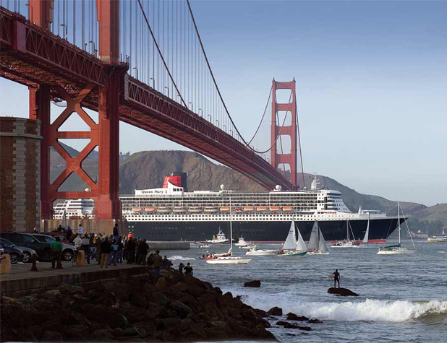
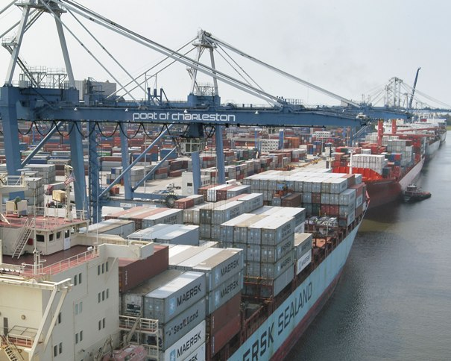
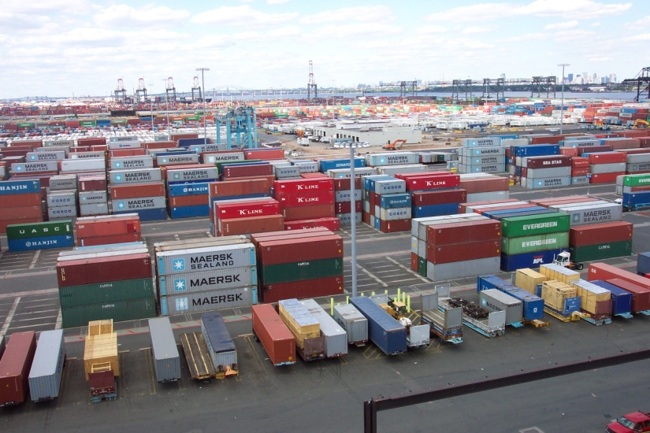
Legislative Issues – MTS Hearings
House Transportation and Infrastructure Committee
June 14: “Creating Jobs and Increasing U.S. Exports by Enhancing the Marine Transportation System”
October 26: “The Economic Importance of Seaports: Is the United States Prepared for 21st Century Trade Realities?”
Jon Rendell Port of San Francisco

Slide 14
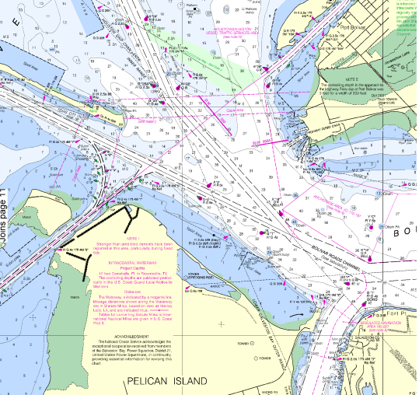
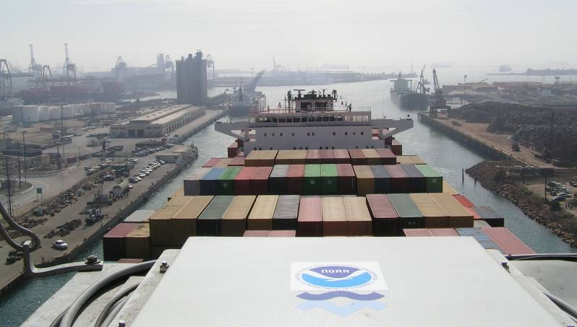
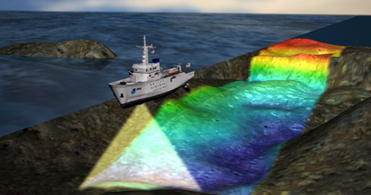
Legislative Issues – DOT Surface Reauthorization and HMTF
Maritime section
Harbor Maintenance Trust Fund (HMTF) provision
Seeks to streamline/expedite permitting processes
CMTS recognition and authorization
Other HMTF legislation

Slide 15
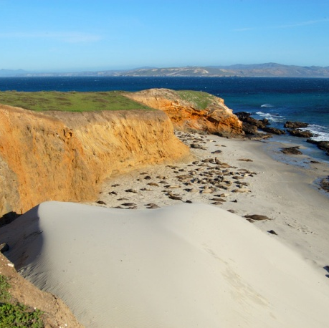
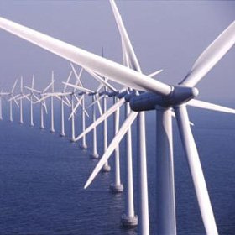
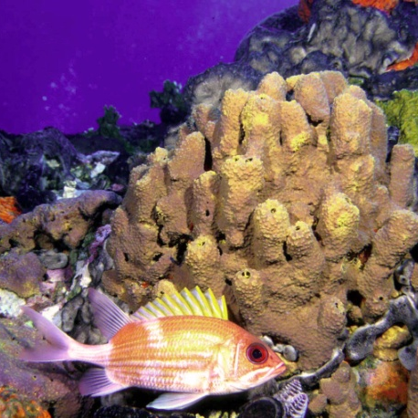
Legislative Issues – National Ocean Policy
House Natural Resources Committee
“The President’s New National Ocean Policy - A Plan for Further Restrictions on Ocean, Coastal and Inland Activities”
October 4, 2011 hearing, with stakeholders only
October 26 hearing – Dr. Lubchenco, Nancy Sutley (CEQ), and more stakeholders

Slide 16
Legislative Issues – HSIA Reauthorization
Hydrographic Services Improvement Act of 1998
Authorization expires at end of FY 2012
Reauthorized/amended in 2002 and 2008
Gives NOAA broad authority in acquiring and disseminating hydrographic data and in providing hydrographic services, which is broadly defined to include all of what Coast Survey, NGS, and CO-OPS do
Establishment of HSRP mandated in 2002 Amendment, refined in 2008 version
New needs?

Slide 17
Policy Highlights
National Ocean Policy
Committee on the Marine Transportation System
NOAA Leadership engagement
Secretary Bryson appointment

Slide 18
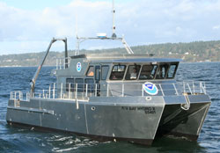
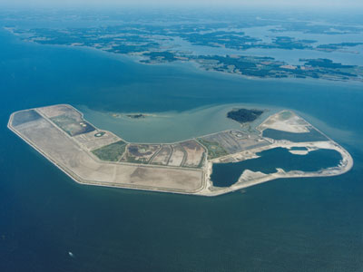
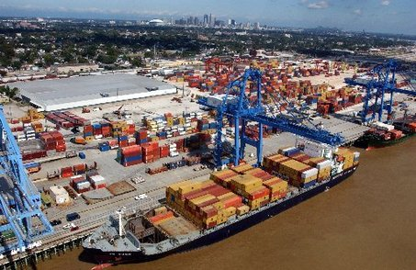
Congressional Outreach
Strengthen existing relationships
Identify new Nav Services champions
Pursue Congressional briefings
Site visits, tours, etc.
Bay Hydro II
Poplar Island
New Orleans/LMR

Slide 19
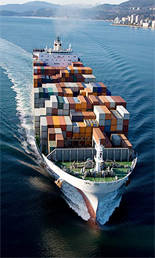
Constituent Affairs
Constituents:
326 public/private ports
3700 marine terminals
12 million cruise passengers
78 million recreational boaters
110,000 fishing vessels
Significance of the MTS:
13 million jobs, $1 trillion+ annually to U.S. GDP
95% of U.S. foreign trade in/out by ship

Slide 20
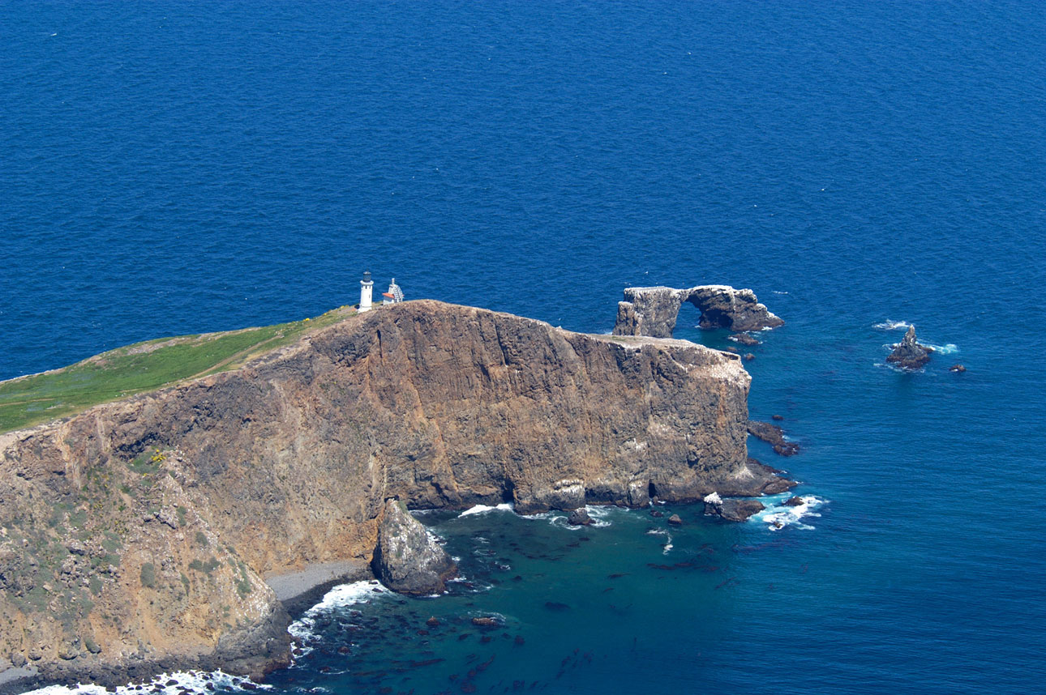
Questions?

